Slide 1
10m dia, 100 A
m = 10, 100, 1000 kg

Slide 2
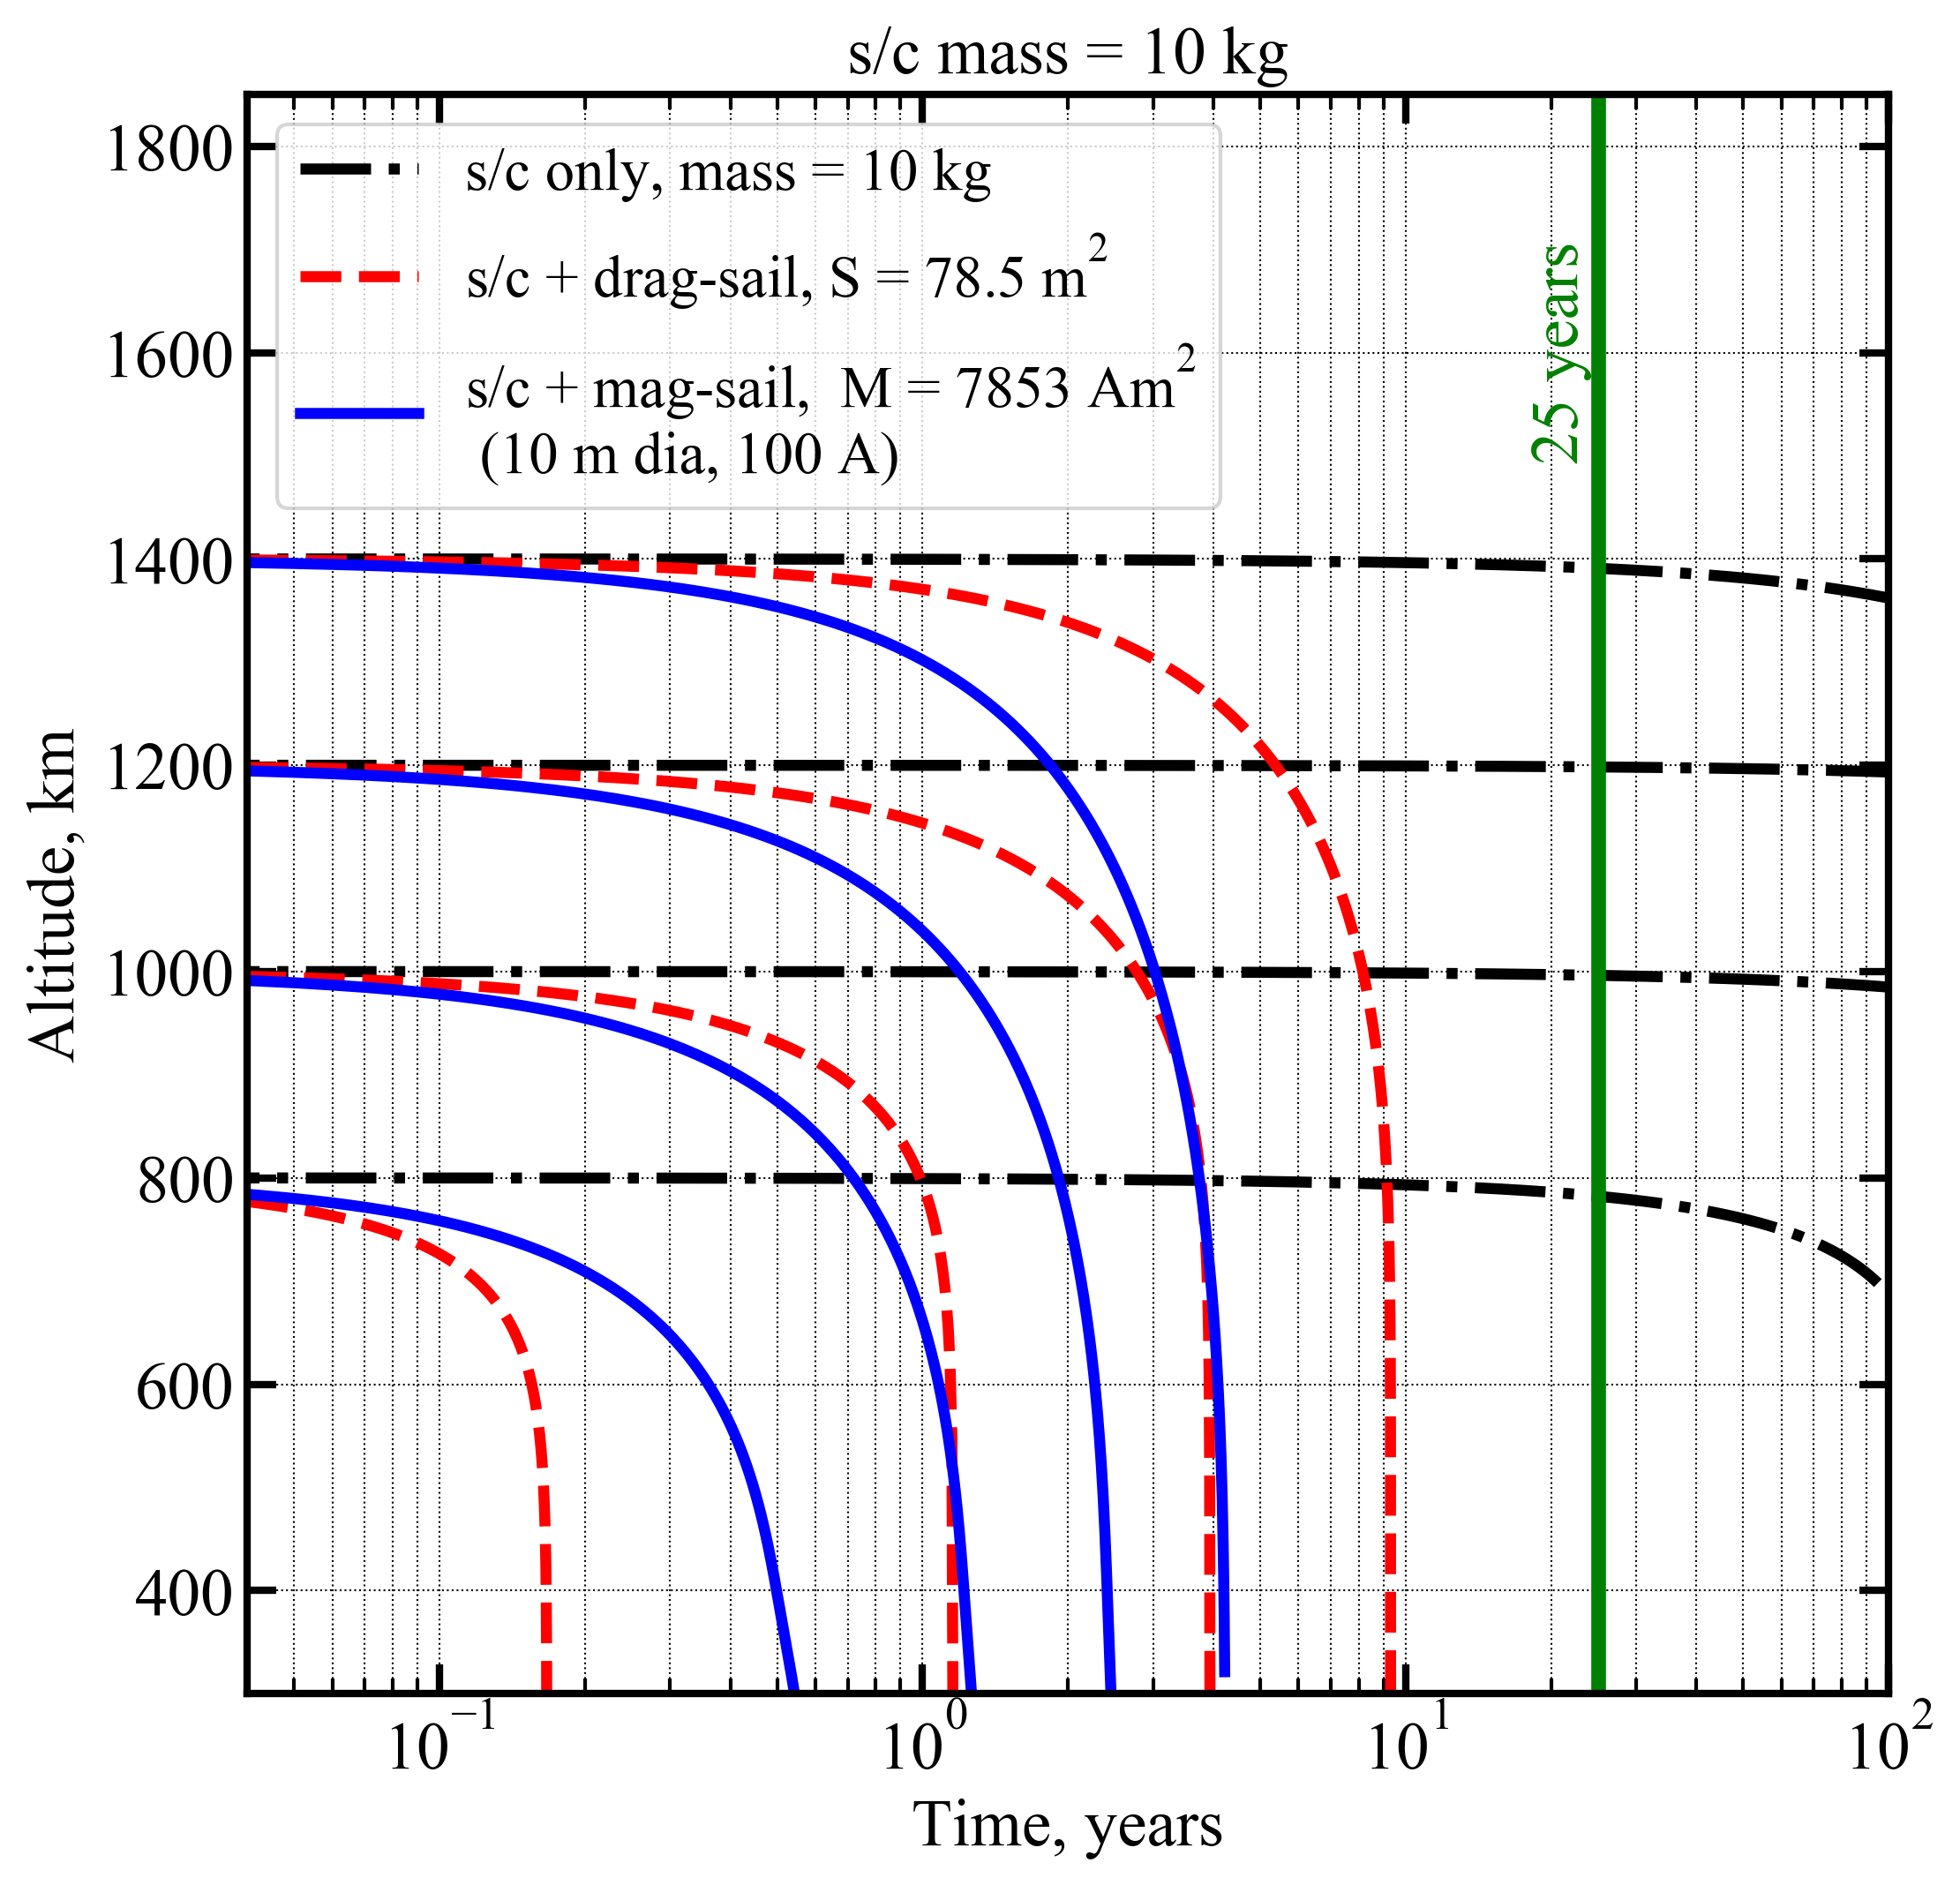

Slide 3
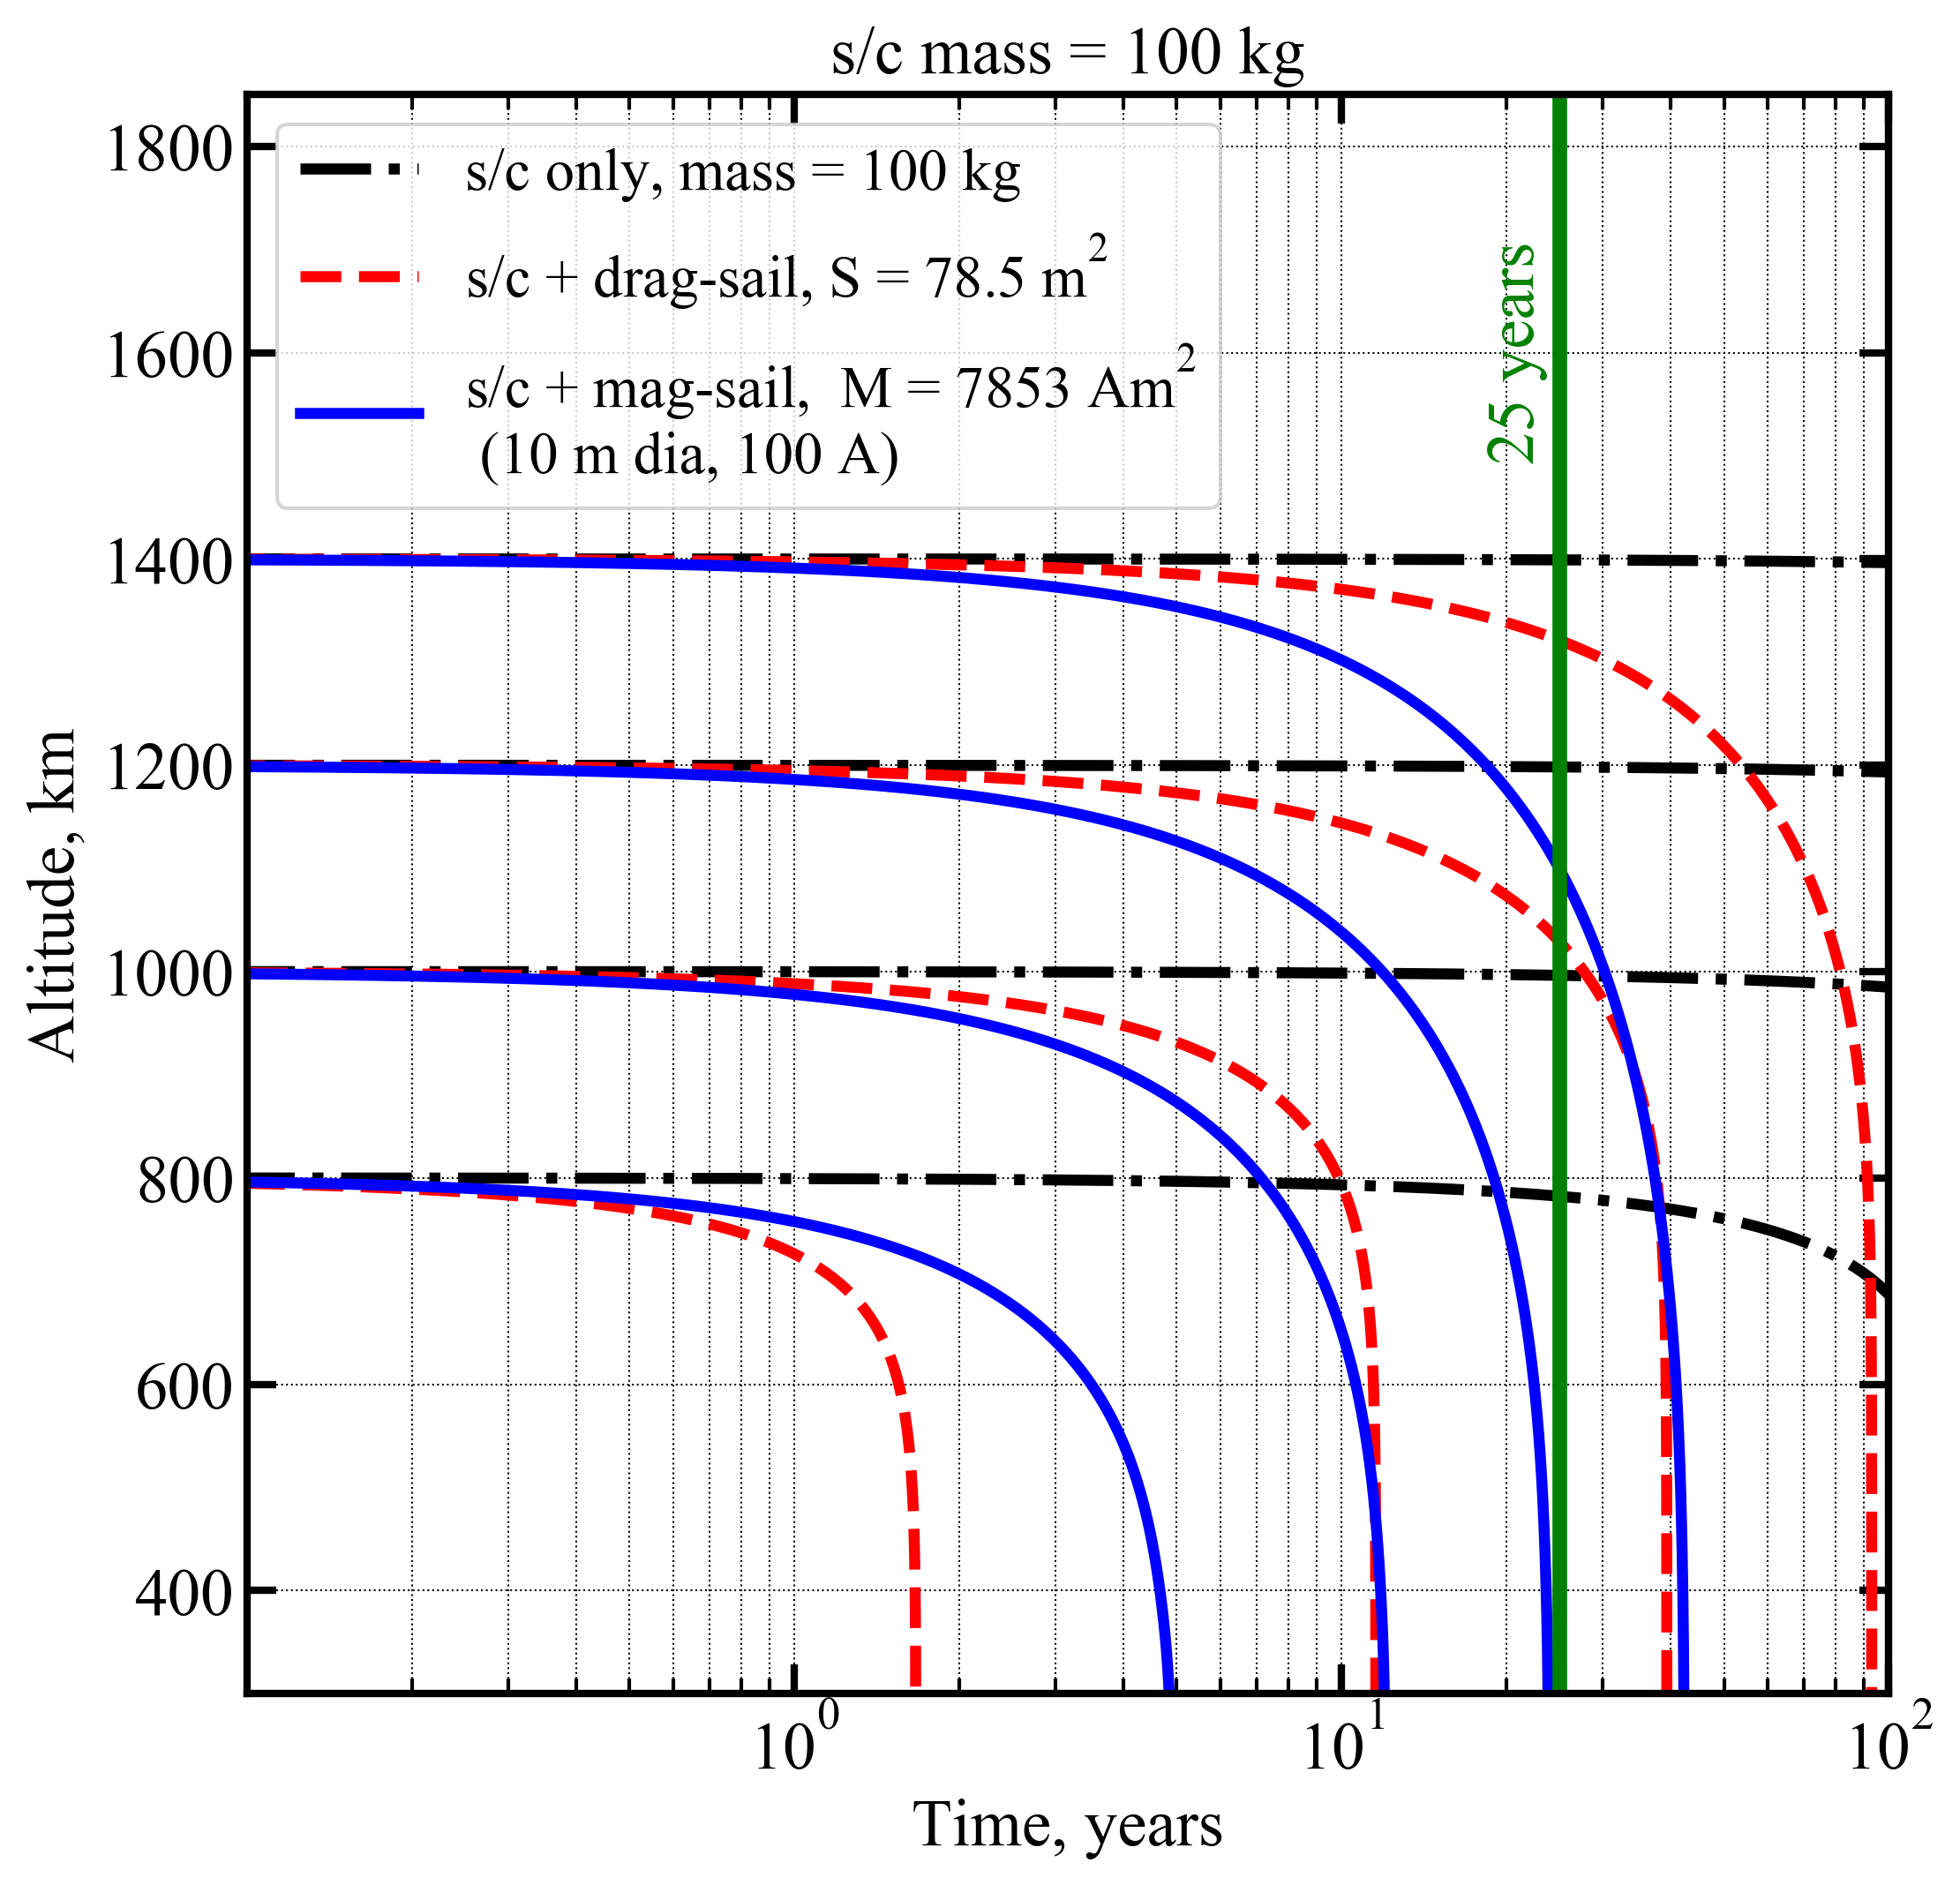

Slide 4
